Slide 1




Best Practices in Managing Tens of Petabytes of Data
Computational and Information Systems Laboratory
Bill Anderson
National Center for Atmospheric Research
HPCSYSPROS 2018

Slide 2
Acknowledgements
Pam Hill
Irfan Elahi
Marc Genty
Chris Hoffman
Zach Mance
Joey Mendoza

Slide 3
Introduction
Challenges in managing large amounts of data:
Data growth continues
* Data Source: Fontana, R., Decad, G. 2018. A Ten Year Storage Landscape LTO Tape Media, HDD, NAND, 34th International Conference on Mass Storage Systems and Technologies (May 2018).
Notes:
- firehose

Slide 4
Introduction
Challenges in managing large amounts of data:
Stakes are high
Security break-ins can result in loss of data (Code Spaces went out of business)
Firmware/software bugs
Administrator error

Slide 5
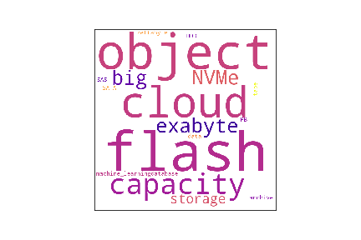
Introduction
Challenges in managing large amounts of data:
Technology is changing rapidly

Slide 6
Introduction
National Center for Atmospheric Research (NCAR) has over 100 PB of data storage in its HPC environment
Have managed large amounts of data for several decades
Share our experience and best practices we’ve learned over the years

Slide 7
HPC Architecture
Cheyenne
SGI ICE-XA
Geyser, Caldera,
Pronghorn, Casper
DAV clusters
GLADE
Central disk resource
38 PB, 300 GB/s
Campaign Store
Archival resource
20 PB, 76 GB/s
High Bandwidth Low Latency HPC and I/O Networks
EDR InfiniBand and 40Gb Ethernet
Data Transfer
Services
Globus, GridFTP
NCAR HPSS Archive
100 PB capacity
~15 PB/yr growth
Science Gateways
RDA, ESG. CDG
40Gb Ethernet
Remote Vis
Partner Sites
XSEDE Sites

Slide 8
Outline
User Needs and Workflows
Architecture
Performance
Data Integrity
On-going Maintenance and Support
Issues when Scaling Systems
The Future

Slide 9
User Needs and Workflows
Notes:
- USERS MAY NOT KNOW WHAT THEY NEED

Slide 10
User Needs
Understanding user needs is critical, especially for very large systems
Don’t want to spend millions of dollars on something that isn’t used
Some Key Needs:
Capacity
Data lifetime(s)
Performance
User interface
Notes:
USERS MAY NOT KNOW WHAT THEY NEED
Meet users at least half way

Slide 11
User Needs: Workflow
Problem
Computation
local
Analyze
Results
Visualize
Results
Publish
Results
Scratch
Global
Archive
Storage Pool
11

Slide 12
Architecture

Slide 13
Architecture
Storage Hierarchy
burst buffer
filesystem
performance
Data lifetime
campaign storage
archive
Notes:
CHANGE DUE TO FLASH
Addition of campaign storage

Slide 14
Architecture
Interoperability
Will everything work together well?
What are other sites doing?
Worth engaging with others

Slide 15
Architecture
Performance is a key aspect of storage architecture
How do you architect a system to meet specific performance requirements?
How do you know if a system is performing as expected?

Slide 16
Performance

Slide 17
Performance
How do you architect a system to meet specific performance requirements?
Assumes you have requirements
Options:
Take advantage of vendor knowledge
Use specs for different components to match performance and check overall thr0ughput or IOPS
Benchmarks: specific, measurable, reproducible
All Three

Slide 18
Performance
Benchmark should be as close as possible to real workload
Real workload on storage systems can be very complex
Client
Client
Client
…
Server
Server
…
Server

Slide 19
Performance
I/O patterns from multiple processes that change over time can be hard to capture in a benchmark
Need to approximate
At NCAR: sustained bandwidth for data transfer and sustained metadata operations per second

Slide 20
Performance
Benchmark tool examples: IOR, mdtest
Can re-run benchmark after upgrades or other changes to ensure that performance still meets requirements

Slide 21
Performance
Storage benchmarks and tests have helped NCAR over the years:
We found that one parallel file system had very different performance if tests were run on certain client nodes
As part of one large supercomputer procurement, found that the parallel filesystem performance was significantly less than expected
Found data corruption in one vendor’s filesystem

Slide 22
Performance
Common causes of storage performance problems:
Too many copies of data being made in the data path
Inefficient use of storage system components, including networks (e.g., small I/O request sizes)

Slide 23
Data Integrity

Slide 24
Data Integrity
Data integrity means that the data read from the system matches what was written to it
Increased probability of error with larger storage systems

Slide 25
Data Integrity
Lots of places where data can be corrupted
Possibility of bit rot
Client
Client HBA
network
Server HBA
Server
Notes:
- highlight: network errors, bit rot, etc

Slide 26
Data Integrity
Most components have some form of error detection or error correction
Disks have ways to detect and correct some errors
Ethernet and TCP have checksums to detect errors
Some filesystems, like ZFS, use checksums on every data block

Slide 27
Data Integrity
Yet, errors can still occur
At one site, bad firmware on network switch caused data to be corrupted
At NCAR, flaky HBA caused data corruption (data pattern dependent)
Notes:
- What does GPFS do for data integrity?

Slide 28
Data Integrity
“Gold standard” is end-to-end data integrity protection
Can use cryptographic checksum (e.g., MD5, SHA1/2) for each file to achieve end-to-end data protection
Calculated and verified on client side (T10-PI)
T10-PI or build your own
Notes:
- Does GPFS have end-to-end data integrity protection?

Slide 29
On-Going Maintenance and Support

Slide 30
On-Going Maintenance and Support
Be aware that firmware upgrades can be risky
Have heard of cases where sites lost filesystems or data

Slide 31
On-Going Maintenance and Support
Read release notes carefully; will the new firmware really fix a problem you have?
If need to upgrade:
Install on test system
Wait until firmware has been out in the field for a few months, if possible

Slide 32
On-Going Maintenance and Support
Proactive error monitoring – important to identify minor problems before they become major
We use Nagios – hundreds of checks:
Filesystem approaching 90% full
Critical backup failed
NTP died (needed for kerberos)
Have detected numerous minor problems and corrected them before they became major

Slide 33
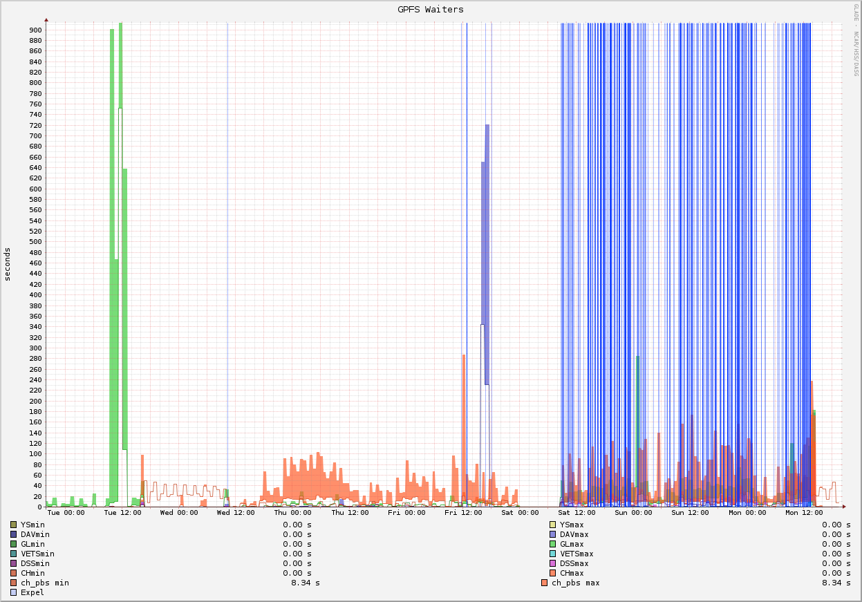
On-Going Maintenance and Support
Track system metrics

Slide 34
On-Going Maintenance and Support
Metrics are a longer term investment that can pay big dividends down the road (e.g., for capacity planning)

Slide 35
Issues When Scaling Systems

Slide 36
Issues when Scaling Systems
Need to have a full stack test system
Serving many more users; can’t have large system down for days to troubleshoot a complex upgrade procedure
Need to be able to test patches; a bug in a new version of software caused us to lose a test filesystem rather than the production filesystem

Slide 37
Issues when Scaling Systems
Plan for a lot more automation
Not possible to run commands manually on large numbers of nodes
Can’t look through 1000’s of messages files
Can’t just run sar on hundreds or more nodes and make sense of the output
Notes:
- Languages like bash and python are your friends

Slide 38

Issues when Scaling Systems
Problems scale too
More problems
Also, new types of problems show up:
Software and hardware often aren’t tested as much at scale
New software (needed to manage larger systems) can lead to new problems

Slide 39
Issues when Scaling Systems
Coordinating with Others
Relying much more on teammates and colleagues
Won’t be plugging in network cables yourself
Security team
Operations group
Tighter relationship with vendor

Slide 40
The Future

Slide 41
The Future
“It’s tough to make predictions, especially about the future” – Yogi Berra

Slide 42
The Future
May not be able to predict the future, but can prepare for different possibilities
NCAR set up an HPC futures lab; great way to explore and test new storage technologies on premises and in the cloud

Slide 43
Summary
Understand user needs
Engage with other sites and the community
Performance benchmarks are worthwhile
Seek end-to-end data integrity
Be careful with firmware upgrades
Track system metrics
Test and explore latest technologies

Slide 44


